Slide 1


Slide 2
GROUP MEMBERS:
P. Srujana AP21111200005
T. Naga Harshitha AP21111200001
A. Venkatavasu AP21111200003
D. Rajitha AP21111200006

Slide 3
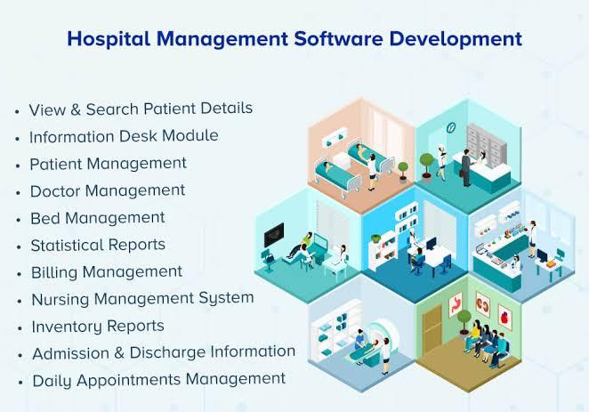

Slide 4
ABSTRACT:
Many hospitals currently use a manual system for the management and maintenance of critical information.
The current system requires numerous paper forms, with data stores spread throughout the hospital management infrastructure.
Often information is incomplete, or does not follow management standards.
Multiple coples of the same information is incomplete exist in the hospital and may lead to inconsistencies in data in various data stores.

Slide 5
OBJECTIVE:
The objective is to customize and deploy an integrated software.
Helps in efficient management of the hospital.
Enhance patient care.
Improve work efficiency.
Improve fiscal control.
Enable the growth of the hospital.

Slide 6
INTRODUCTION:
Hospitals are the institutions proving medical and surgical treatment and nursing care for any ill or injured people.
It is an integral part of social and medical organization, the function of which is to provide complete health care to the needy one, both curative and preventive. It is also a center for proving training to health workers and center for biosocial research.

Slide 7
GOALS:
To improve the generations of MIS with real time response.
To control credit
To make the hospital/office paperless.
To make technology add to bottom-line of the company.
To enable the executives to make decisions on a click of a mouse.
To improve decision making.

Slide 8
SYSTEM REQUIREMENTS SPECIFICATION:
SOFTWARE REQUIREMENTS :
Language used : c
Operating system : Windows 7
HARDWARE REQIREMENTS:
Hard disk : 50GB
Processor : 62-bit

Slide 9
SYSTEM DESIGN:

Slide 10
ALGORITHM :
STEP-1: Start
STEP-2: Open registration page
STEP-3: Allocate memory for new patient information
STEP-4:Enter information
STEP-5: Create unique patient ID

Slide 11
STEP-6: Create user name and password
STEP-7: Create entry to the database
STEP-8: Allocate doctor for the patient
STEP-9: Tests and reports entry
STEP-10: Initiate advance fees
STEP-11: Allocation of bed and room for patient
STEP-12: Patient health progress
STEP-13: Patient discharge
STEP-14: Pending fees and updation
STEP-15: End

Slide 12
Flow Chart:
START
CREATE RECORD ENTRY DATABASE
REGISTRATION
DOCTOR ALLOCATION
NEW PATIENT
LOGIN PATIENT ID
CREATE PATIENT ID
TEST & REPIRTS ENTRY
CREATE USERNAME AND PASSWORD

Slide 13
ADVANCE FEES ENTRY
INFORMATION ENTRYBTO DATA BASE
BED & ROOM ALLOCATION
PATIENT PROGRESSS
PATIENT DISCHSRGE

Slide 14
SYSTEM IMPLEMENTATION:

Slide 15
IMPORTANTS FUNCTIONS IN THE PROGRAM:
Void emp ( ) – for creating employe details
Void menu ( ) – for creating main menu
Void pat ( ) – for creating patient details
Void inv ( ) – for purchasing inventory

Slide 16
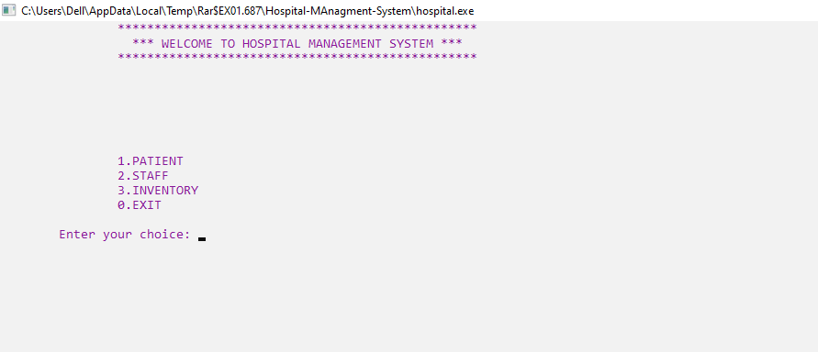
OUTPUT:

Slide 17
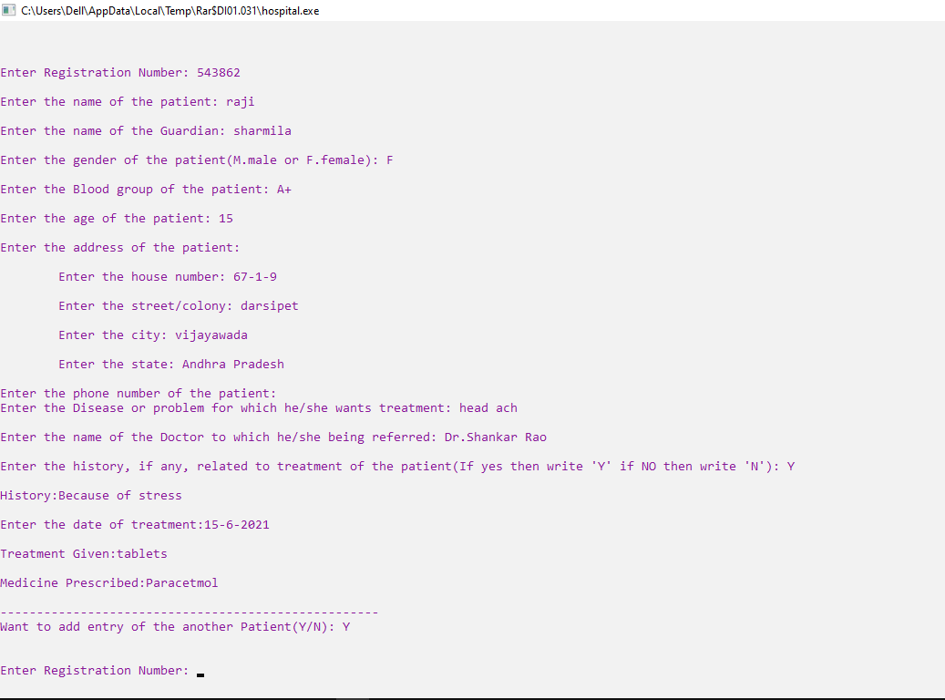

Slide 18
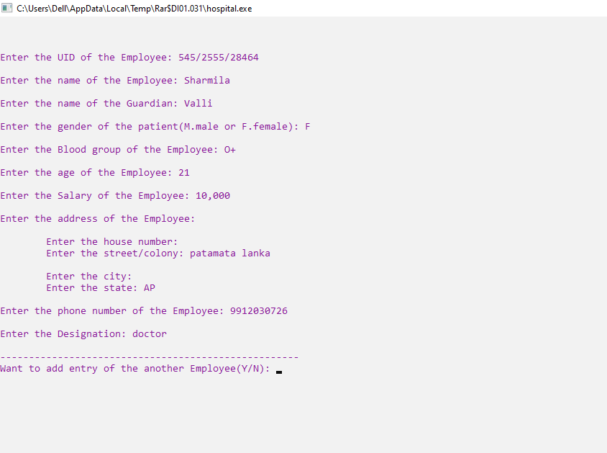

Slide 19
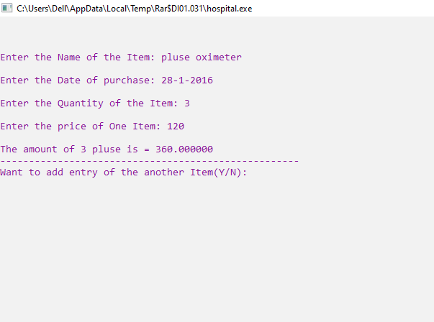

Slide 20


